Slide 1
Making Fertilizer Subsidies
Smart with Savings
Dean Yang
University of Michigan
deanyang@umich.edu

Slide 2
Motivation
The returns to saving and investment are high in many developing countries
  de Mel, McKenzie and Woodruff (2008)
  Duflo, Kremer and Robinson (2009)
In sub-Saharan Africa, fertilizer is one of the highest-return and most under-exploited investment opportunities for smallholder farmers
Government response has been large-scale fertilizer subsidies for smallholders (Malawi, Tanzania, etc.)
  In Malawi, 11% of government budget in 2010/11
  Unsustainable without continued donor support

Slide 3
Fertilizer use, smallholder farmers in central Mozambique
Data are from authors’ survey of farmers in Manica province (Carter, Laajaj, and Yang 2011). Surveys implemented in Mar-May 2011, reporting on fertilizer use in 2009-2010 season.
Notes:
Mozambican farmers’ use of fertilizer on their crops is substantially below optimal levels.

Slide 4
Today
For today: the latest of a series of experiments in rural southern Africa aimed at raising farm output via financial service provision
  Precursor projects in neighboring Malawi

Slide 5
Raising farm output with rural finance
Insure farmers against adverse events
  Provide insurance against poor rainfall
Facilitate credit for agricultural inputs
  Improve repayment via biometric identification
Encourage farmers to save for their own input purchases
  Provide basic savings access
  Provide “commitment” savings devices
  Couple fertilizer subsidies with savings
  Provide large savings matches

Slide 6
Vicious circles in input or credit provision
Higher harvest income
Provision of inputs
E.g., via subsidies or credit
Earnings dissipated prior to next season

Slide 7
Vicious circles in input or credit provision
Higher harvest income
Provision of inputs
E.g., via subsidies or credit
Earnings dissipated prior to next season
→ Why do farmers have trouble maintaining savings between one harvest and the next?

Slide 8
Increased incomes via savings facilitation
Higher crop output
Input purchases from new savings alone, without subsidy
Saving for future input purchases
Initial subsidy for inputs, higher output

Slide 9
Increased incomes via savings facilitation
Higher crop output
Input purchases from new savings alone, without subsidy
Saving for future input purchases
→ Focus of this research
Initial subsidy for inputs, higher output

Slide 10
Key questions
What is the impact of fertilizer subsidies on fertilizer use and farm output?
  Differentiate between impacts in short and longer run (during vs. after subsidy)
What is the impact of basic savings provision?
Do fertilizer subsidies have larger long-term impacts when combined with savings?
Does savings provision have larger impacts when combined with…
  fertilizer subsidies in previous season?
  substantial savings matches?

Slide 11
The agricultural cycle in Mozambique
Rainy season
May
June
July
August
September
October
November
December
January
February
March
April
Harvest
Planting
“Hungry season”

Slide 12
The agricultural cycle in Mozambique
Rainy season
May
June
July
August
September
October
November
December
January
February
March
April
Harvest
Savings need to span this period
Planting
“Hungry season”

Slide 13
This project
1,612 farm households in central Mozambique (Manica province)
Random assignment of fertilizer subsidies
Random assignment of savings interventions
  Basic savings access
  50% “match” of savings in period between harvest and planting
All study participants (including control group) offered education session on saving for fertilizer
  Helps distinguish savings treatments from “encouragement” to save for fertilizer

Slide 14
Treatments
Households randomly assigned to 1 of 6 possible treatment combinations:
Randomization of fertilizer subsidies at individual level within village
Randomization of savings interventions at locality level, across 63 localities
 | No savings | Basic savings | Matched savings
No fertilizer subsidy | 267 hhs | 283 hhs | 245 hhs
Fertilizer subsidy | 247 hhs | 311 hhs | 240 hhs

Slide 15
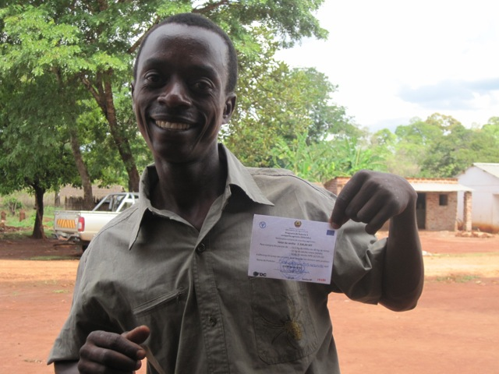
A fertilizer subsidy “winner”
50% of registered farmers within each study village randomly assigned to voucher receipt

Slide 16
Voucher details
Funded by EU, distributed by FAO/IFDC in November 2010
Inputs provided in package:
  100 kg. of fertilizer (50 kg. urea, 50 kg. NPK)
  12.5 kg. of improved maize seeds
Designed for 1/2 hectare maize plot
Value of voucher:
  The total value of package: MT 3,160 (~US$113)
  Voucher funds MT 2,300 (72.7%)
  Voucher recipient must fund remainder in cash

Slide 17
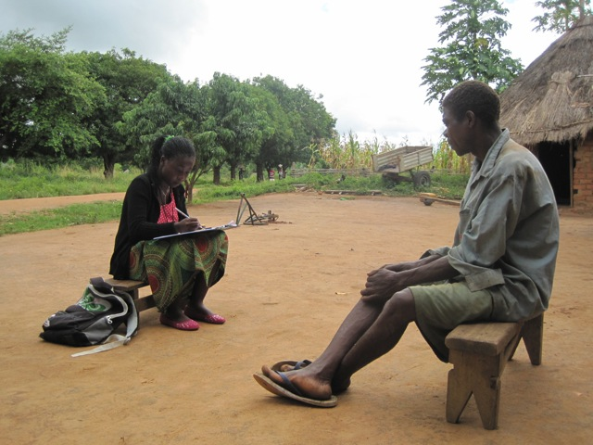
First (“baseline”) survey
Administered Mar-May 2011
Precedes savings intervention, but after fertilizer randomization

Slide 18
Timeline
November 2010
  Random assignment of fertilizer vouchers
March – May 2011
  First (“baseline”) survey
  Random assignment of savings interventions
August – September 2011
  Post-harvest survey (to measure impact of fertilizer subsidies, and initial impact of savings interventions)
2012, 2013
  Subsequent post-harvest surveys (to measure longer-term impacts of all treatments)

Slide 19
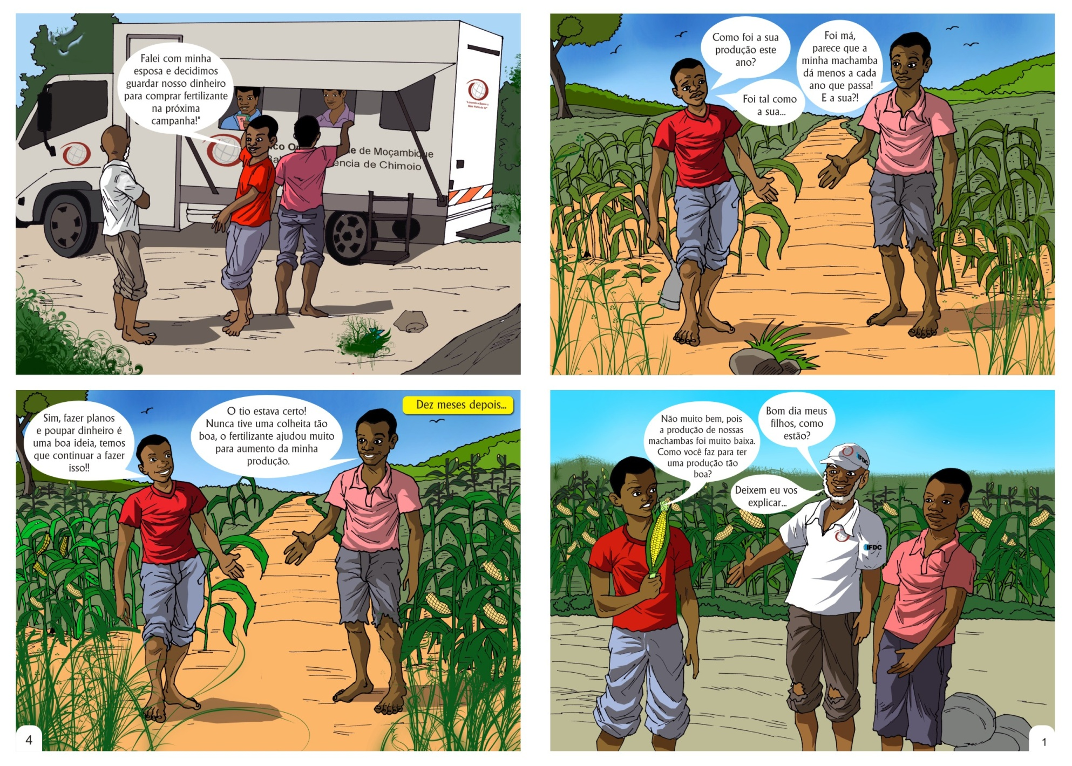
Educational material on savings and fertilizer

Slide 20
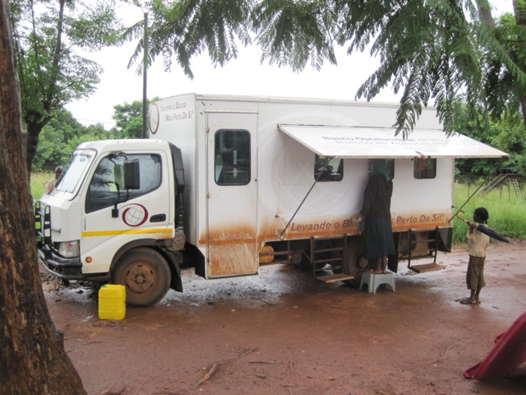
Partner bank
Savings accounts at Banco Oportunidade de Mocambique (BOM)
Access via 2 branches and scheduled visits by mobile units

Slide 21
Savings accounts and matches
Accounts offered in “basic savings” treatment are standard savings accounts
  Normal interest rate
Savings match:
  50% of minimum balance over match period
  Matching funds capped at MT1500 (~$54)
  Match period: August 1 – October 31
  Two years of match promised: 2011 and 2012
  Designed with agricultural cycle in mind
    Match period ends immediately prior to start of next planting season
    If save full amount (MT3000), savings + match can purchase input package sufficient for 3/4 hectare plot

Slide 22
Voucher redemption
Voucher redemption rates:
  Lottery winners: 48.3%
  Lottery losers: 12.1%
    Due to imperfect adherence to lottery outcome by government extension workers
  Effect of lottery winning on voucher use: 36.2 percentage points
  An “encouragement” research design
This will be source of variation in outcomes between lottery winners and losers

Slide 23
Impacts of interest (so far)
Impacts of voucher winning on…
  Fertilizer use
  Maize output
Impacts of savings interventions on savings
  Self-reported in Aug-Sep 2011
Interaction effects between voucher and savings experiments
  On savings

Slide 24
Fertilizer/ha. by voucher lottery status
10.8 kg./ha. for voucher losers and 22.3 for voucher winners. Effect of winning voucher lotter y is about 11 kg/ha increase.

Slide 25
Maize yield by voucher lottery status
Yield in tons/ha is 1.52 for voucher losers and 1.58 for voucher winners. Maize yield is about 61 kg/ha higher for voucher winners than for voucher losers, but difference is not statistically significant.

Slide 26
Impacts of interest (so far)
Impacts of voucher winning on…
  Fertilizer use
  Maize output
Impacts of savings interventions on savings
  Self-reported in Jul-Sep 2011
Interaction effects between voucher and savings experiments
  On savings

Slide 27
Savings account ownership by treatment
Share with savings accounts in three groups respectively is: 16%, 33%, and 40%.
Both basic savings and MS treatment effects are significant vs. control group.
P-value of difference in basic savings and MS effects: 0.21.

Slide 28
Savings (in MT) by treatment
Mean savings in three groups respectively in MT is: 2090, 1770, and 4444.
P-values for test of significance of MS treatment effect: 0.16 vs. control group and 0.08 vs basic savings group.

Slide 29
Impacts of interest (so far)
Impacts of voucher winning on…
  Fertilizer use
  Maize output
Impacts of savings interventions on savings
  Self-reported in Jul-Sep 2011
Interaction effects between voucher and savings experiments
  On savings

Slide 30
Savings account ownership by treatment
For both voucher winners and losers, treatment effects of basic savings and MS vs control group are significant.
For voucher losers, effect of basic savings is different from effect of MS at 0.10 level.

Slide 31
Savings (in MT) by treatment
For voucher winners, no treatment effects are significant.
For voucher losers, p-values for test of significance of MS treatment effect: 0.19 vs. control group and 0.10 vs basic savings group.

Slide 32
In sum
In fertilizer subsidy experiment:
  Positive impacts of subsidy on fertilizer use
  But initial analysis provides no evidence of corresponding increases in maize yields
In savings experiment:
  No impact of basic savings
  Large impact of savings match
No interaction effects between subsidies and savings

Slide 33
Still to come
Explore possible reasons behind absence of impact of fertilizer vouchers on maize yields
  Lack of knowledge on optimal use?
  Poor weather?
Surveys (2012 and 2013) to establish effects of savings interventions on farm and other outcomes

Slide 34
Extra slides

Slide 35
Summary statistics
 | Mean | SD | Min | 10th pctile | Median | 90th pctile | Max
Total land size (ha) | 9.0 | 18.2 | 0 | 1.56 | 5 | 15 | 400
hh size | 7.7 | 3.4 | 1 | 4 | 7 | 12 | 27
hh head educ (yrs) | 4.6 | 3.2 | 0 | 0 | 4 | 9 | 13
urea (kg/ha) | 6.2 | 20.7 | 0 | 0 | 0 | 20 | 300
npk (kg/ha) | 5.5 | 18.2 | 0 | 0 | 0 | 16.7 | 185.2
maiz prod (kg) | 2918 | 5239 | 0 | 360 | 1521 | 6400 | 126120
Yield (kg/ha) | 1096 | 1394 | 0 | 166.7 | 680 | 2400 | 12178
Area maize (ha) | 3.59 | 3.8 | 0.21 | 0.72 | 2.5 | 7 | 50

Slide 36
Demographics and financial services
Indicators
Male: | 76.4%
Has formal saving: | 19.9%
Has formal credit: | 12.5%
Languages:
Shona | 43.4%
Chiutewe | 21.4%
Sena | 3.9%
Ndau | 3.6%
Nhugue | 7.7%
Chibarue | 17.8%
Portuguese | 0.1%
Others | 2.0%
Religions:
None | 14.7%
Catholic | 16.7%
Protestant | 68.0%
Muslim | 0.1%
Others | 0.5%

Slide 37
Post-harvest survey
Attrition rate: 9.8%
Test for treatment effect on attrition:
  Regress attrition dummy on dummies for each of 5 treatments and village fixed effects
  F-test for joint signif of coeffs on 5 treatment dummies
    p-value of f-test: 0.58
    → Treatments did not affect attrition
  → Results from post-harvest survey are not confounded by selection bias

Slide 38
Fertilizer use by voucher lottery status
18.4 kg. for voucher losers and 34.5 for voucher winners.

